Slide 1
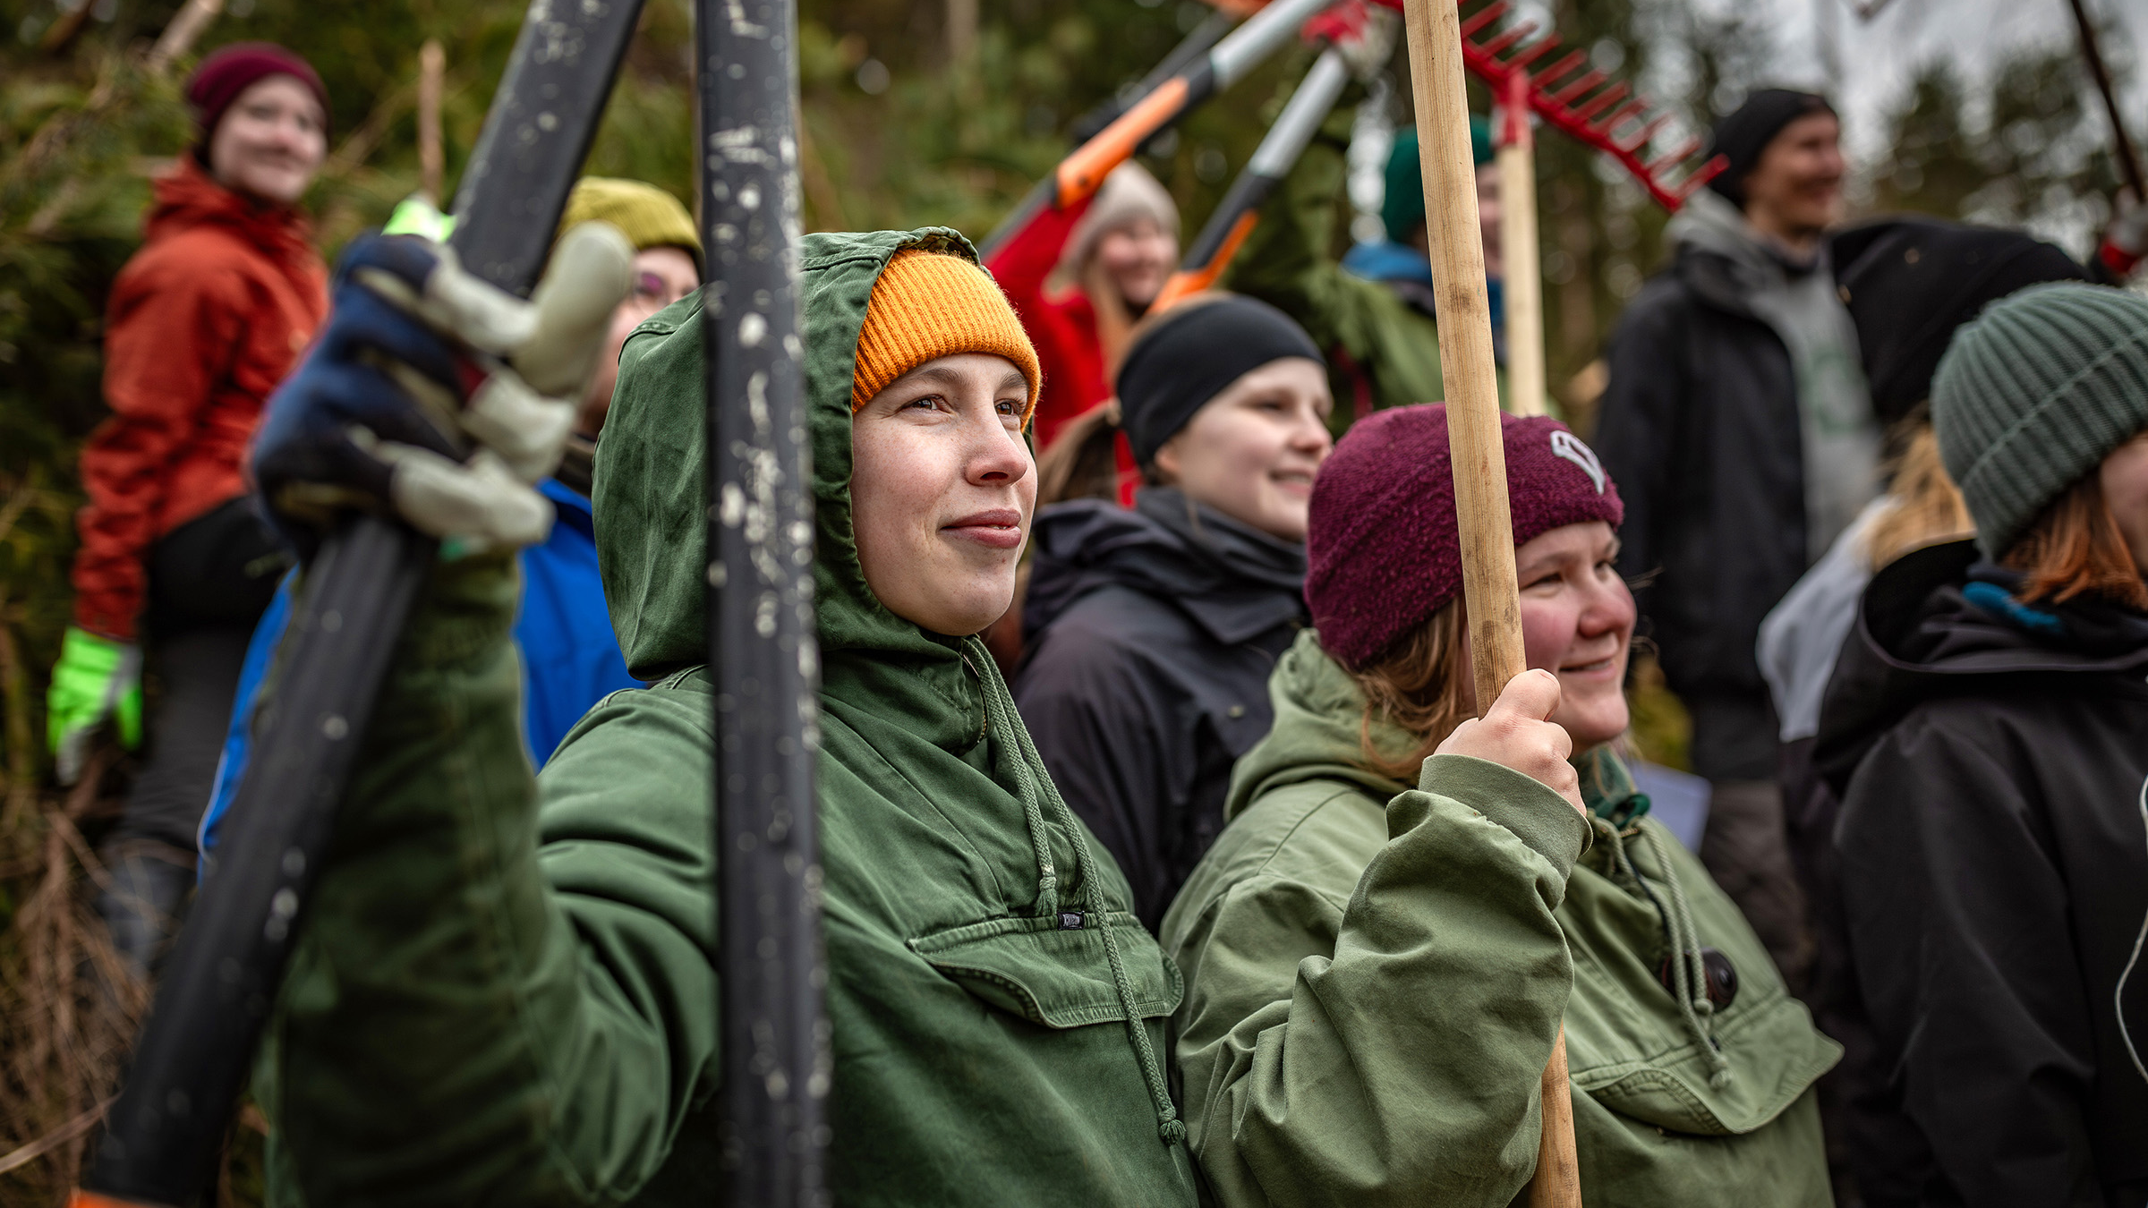

RESTORATION ACADEMY:
MULTIPLIERS’ TRAINING MODEL
Photo: Martin Sopinec

Slide 2

Funded by the European Union. Views and opinions expressed are however those of the author(s) only and do not necessarily reflect those of the European Union or the European Education and Culture Executive Agency (EACEA). Neither the European Union nor EACEA can be held responsible for them.

Slide 3
Instructions for the facilitator
The training model consists of several modules based on the materials, especially the videos and the guide, developed during the Erasmus+ funded Restoration Academy project (2023–2026).
You can use the modules together or separately to design a training that fits your objectives, participants, and available time. As such, using all the modules, the training takes approx. 1-1,5 hours.
The model can be applied for face-to-face, online or hybrid trainings.
Each module begins with facilitation guidelines that describe the steps of the activity, required materials and indicative timing. These are meant to support the facilitator and can be adapted to the needs of the group.
All supporting materials of the training model and other project outputs are available at: https://nuortenakatemia.fi/en/restoration-academy-project-results-and-materials/

Slide 4
Contents
Warm-up
Videos and shared reflection
Nature restoration in practice and our local context
Planning next steps
Closing

Slide 5
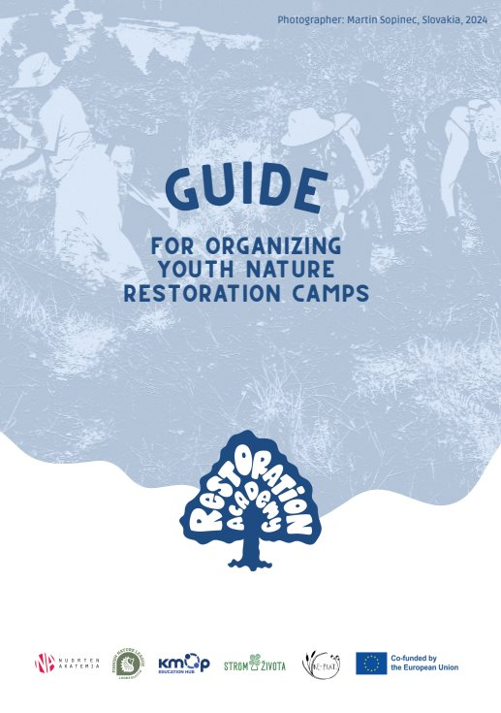
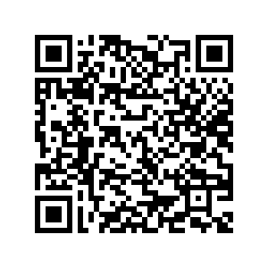
Open the guide:

Slide 6
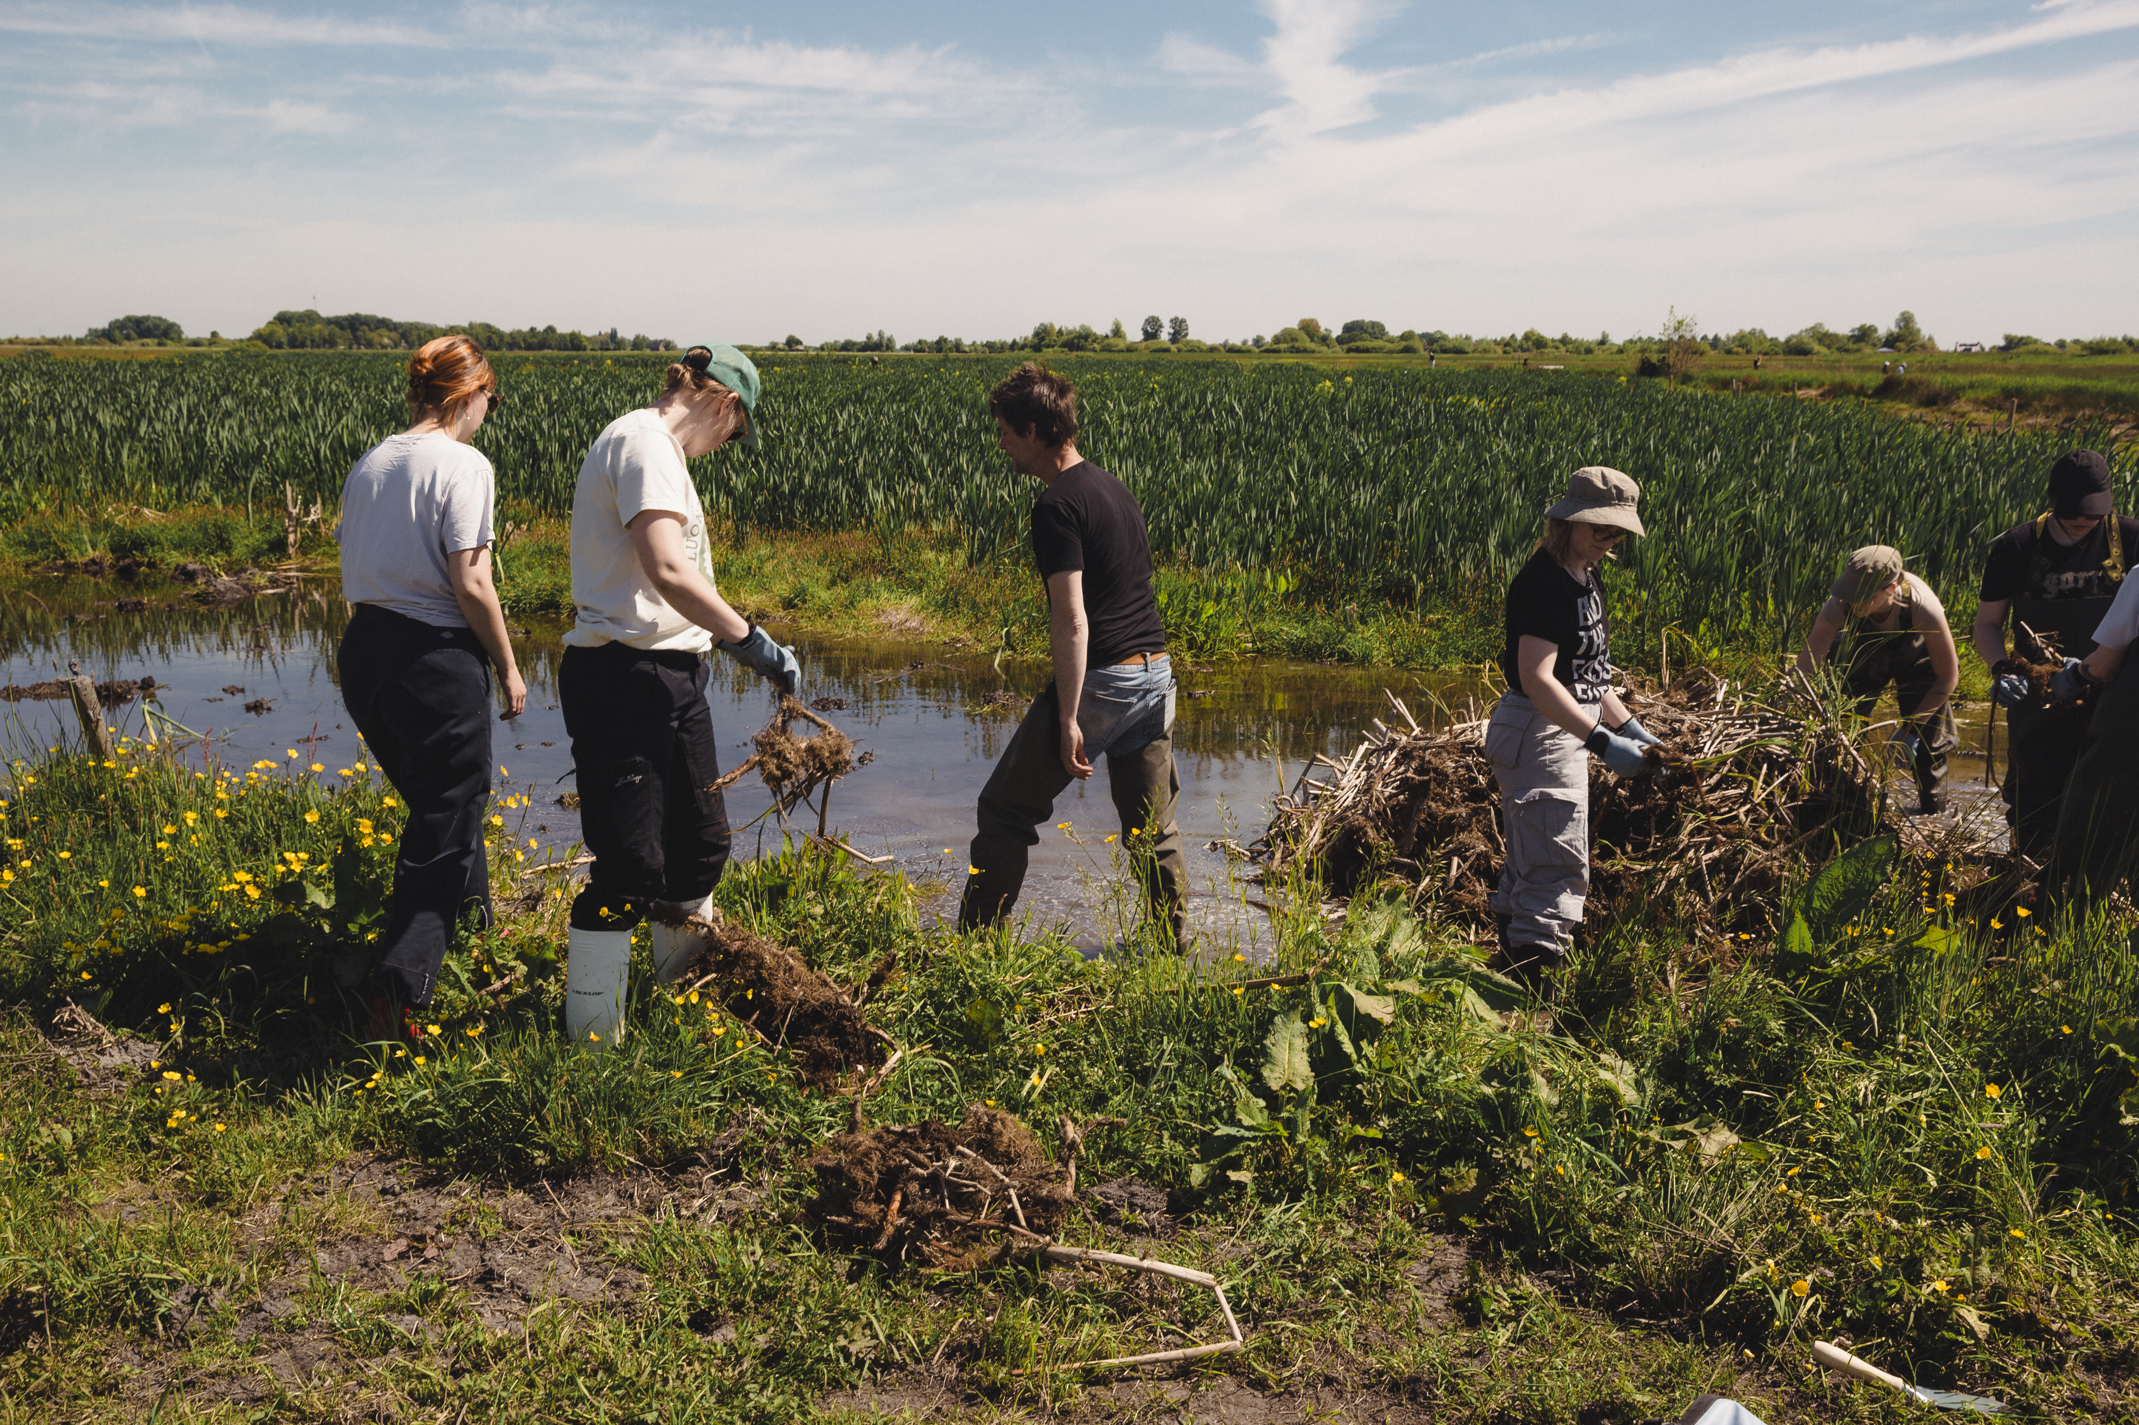
WARM-UP
Photo: Anja Matthes

Slide 7
Instructions for the facilitator
Objective: To activate participants, surface their existing ideas, and create a shared starting point for understanding nature restoration.
Steps, materials, and timing
  Individual reflection (1 minute): Ask participants to reflect on the question: “What is the first thing that comes to your mind when you think of nature restoration?” No writing needed.
  Word cloud (1–3 minutes): Collect responses into a word cloud, for example using post-it notes and pens or a digital tool such as Answergarden. Briefly review together what kinds of ideas emerged.
  Pair or small-group discussion (3–5 minutes): Ask participants to find the definition of nature restoration in the Restoration Academy guide and compare it with the ideas that came up in the word cloud.

Slide 8

What is the first thing that comes to your mind when you think of nature restoration?
Individual reflection and word cloud

Slide 9
Find the definition of nature restoration in the guide and compare it with the ideas that came up in the word cloud.
Discussion in pairs/groups

Slide 10
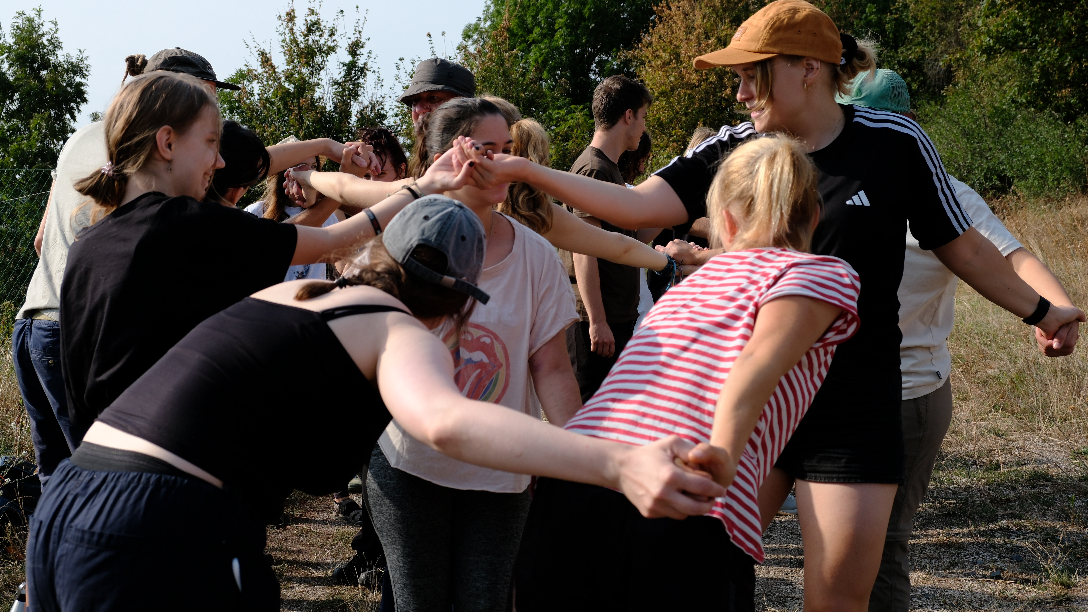
VIDEOS
Photo: Frankie Turk

Slide 11
Instructions for the facilitator
Objective: To deepen understanding of nature restoration through concrete examples and lived experiences.
Steps, materials, and timing
  Watching the video(s) (3-6 min per video): Watch the animation video together. If time allows, you may also show one or more videos from the restoration camps organized as part of the Restoration Academy project.
  Reflective discussion (5–10 minutes):
    Guide participants to discuss in pairs or small groups:
      Did they pay special attention to something in the video(s)?
      Did they learn anything new from the video(s)?

Slide 12
Animation (open in YouTube)
Restoration Academy: Unmute the World (in English)

Slide 13
Videos from the camps (open in YouTube)
Finland
Nature Restoration Camp at the Archipelago Sea National Park in Finland (in English)
Finnish subtitles: Ennallistamisleiri Saaristomeren kansallispuistossa (tekstitetty suomeksi)
Slovakia
Nature Restoration Camp in the Little Carpathians in Smolenice in Slovakia (subtitles in English)
Slovak subtitles: Tábor obnovy prírody v Malých Karpatoch, Smolenice, Slovensko (titulky v slovenčine)
The Netherlands
Nature Restoration Camp in Friesland in the Netherlands (subtitles in English)
Dutch subtitles: Nature Restoration Camp in Friesland in the Netherlands (subtitles in Dutch)

Slide 14

Discussion in pairs/groups
  Did you pay special attention to something in the video(s) or learn anything new from them?

Slide 15
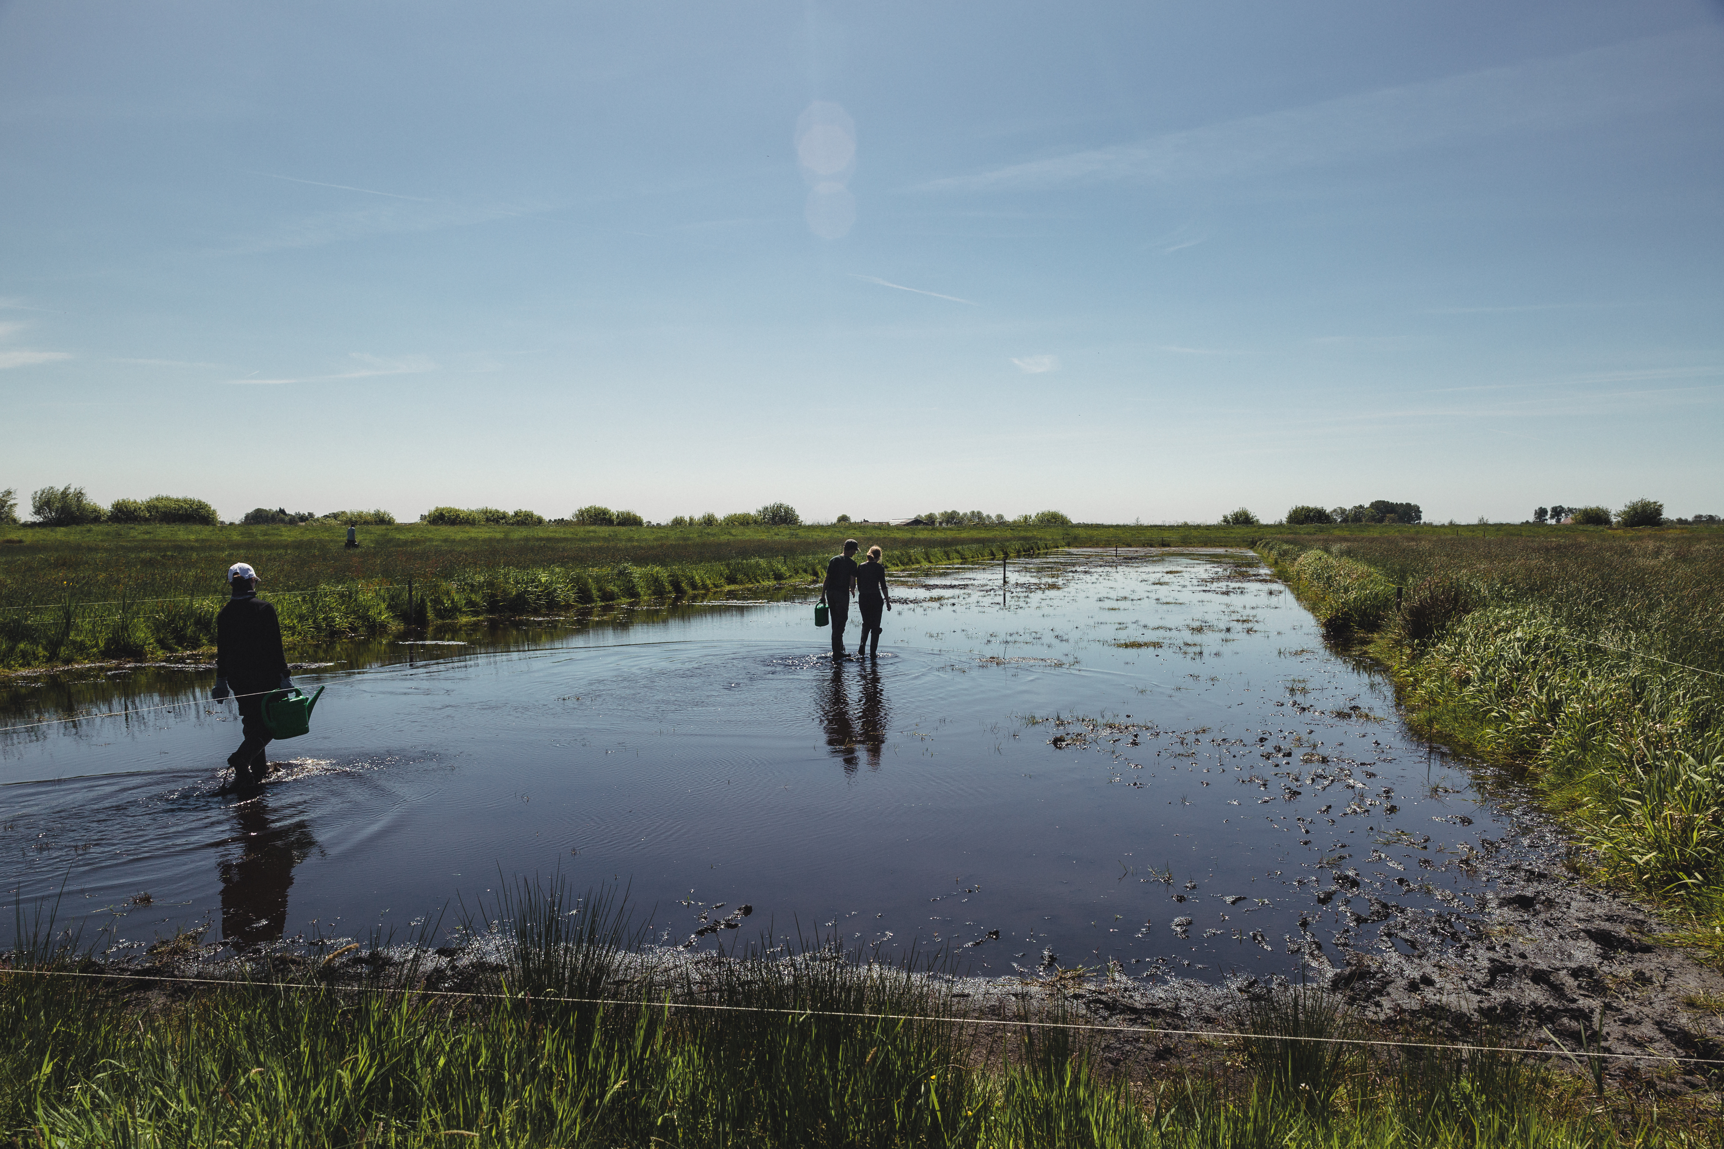
WHAT CAN WE DO
AND HOW TO START?
Photo: Anja Matthes

Slide 16
Instructions for the facilitator
Objective: To move from understanding to action and strengthen participants’ sense of agency.
Steps, materials, and timing
  Make sure everyone has access to the Restoration Academy guide.
  Exploring the guide (10–15 minutes): Ask participants to find answers on a general level to the following questions: Where is it possible to do nature restoration? What kinds of partners are needed? What kinds of environments are suitable for restoration, especially with young people? What can nature restoration look like in practice? Work in pairs or small groups.
  Local perspective (10–15 minutes): Ask participants to shift their focus to their own local context: What restoration projects exist in your area? Which actors are implementing them? Which projects or actors could be suitable for involving young people? At this stage, participants may also search for information beyond the guide.
  Joint reflection: Share key findings together.

Slide 17
Open the guide:

Slide 18
First, try to find answers on a general level for the questions on the following slide:

Slide 19

Where is it possible to do nature restoration?
What kinds of partners are needed?
What kinds of environments are suitable for restoration, especially with youth?
What can nature restoration look like in practice?

Slide 20
Now, shift your focus to your own local context where you’re living or operating at. You can search for more information online. Try to find answers for the questions on the following slide:

Slide 21
What restoration projects exist in your area?
Which actors are implementing them?
Which projects or actors could be suitable for involving youth?

Slide 22
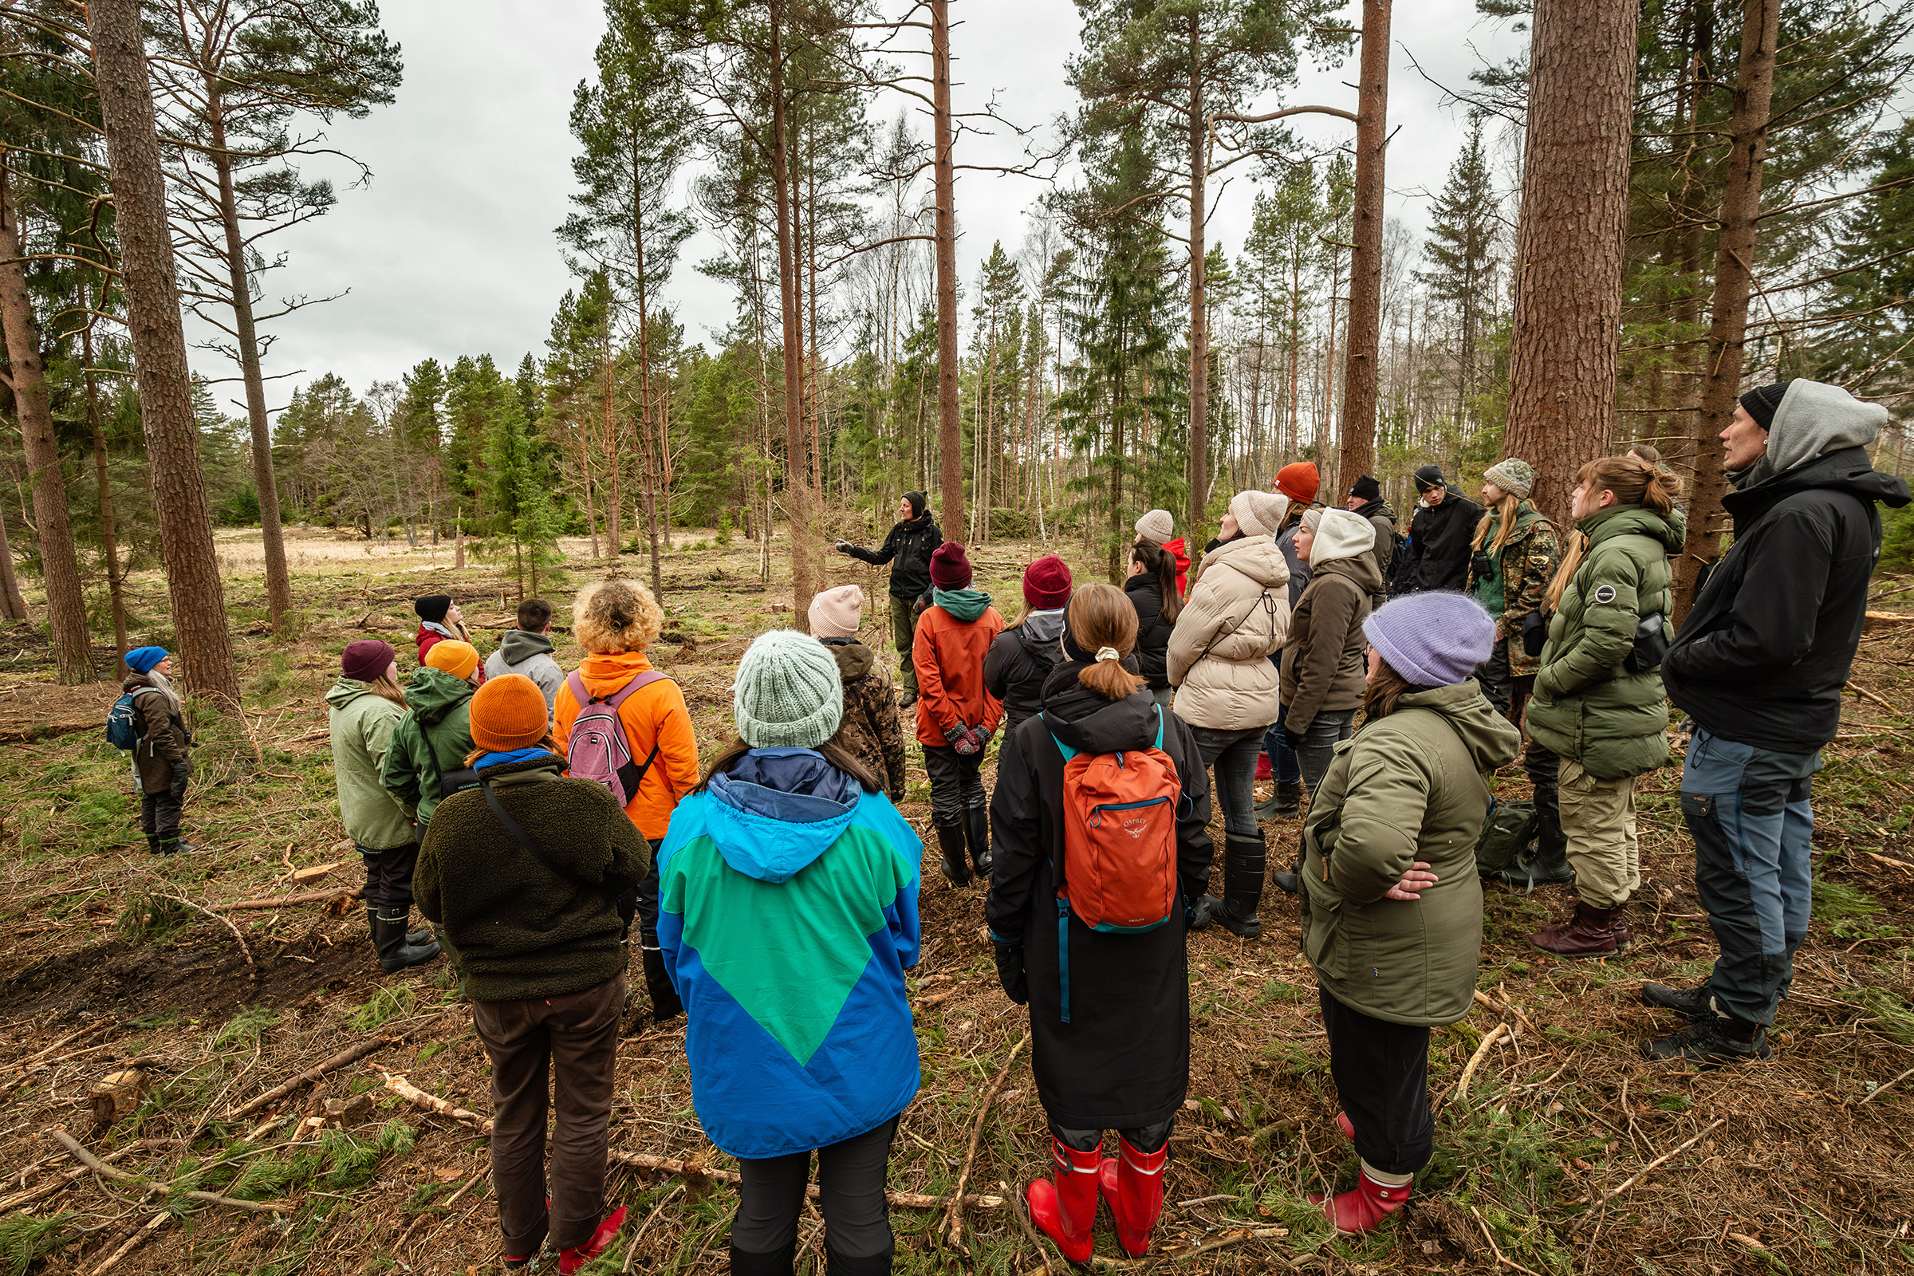
NEXT STEPS
Photo: Martin Sopinec

Slide 23
Instructions for the facilitator
Objective: To support participants in taking concrete steps toward involvement in nature restoration.
Steps, materials, and timing
  Planning next steps (10 minutes): Ask participants to plan 3–5 concrete next steps they can take to engage in nature restoration in their work or voluntary activities. Work individually, in pairs, small groups, or as a whole group. Steps can be written down on paper or digitally. End by sharing ideas together.

Slide 24

Plan your 3–5 concrete next steps
step 1
step 2
step 3
step 4
step 5

Slide 25
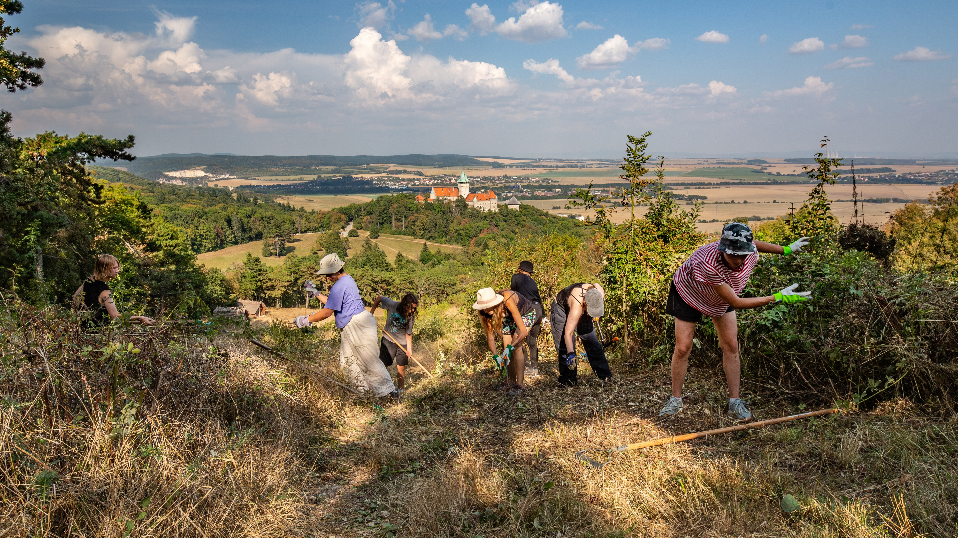
CLOSING
Photo: Martin Sopinec

Slide 26
Instructions for the facilitator
Objective: To ensure continuity and encourage further use of the materials.
Steps
  Explain how participants can continue from here. Make sure they know where to find all the materials.
  Thank participants and encourage them to act as multipliers in their own communities.

Slide 27

Find all the materials

Slide 28
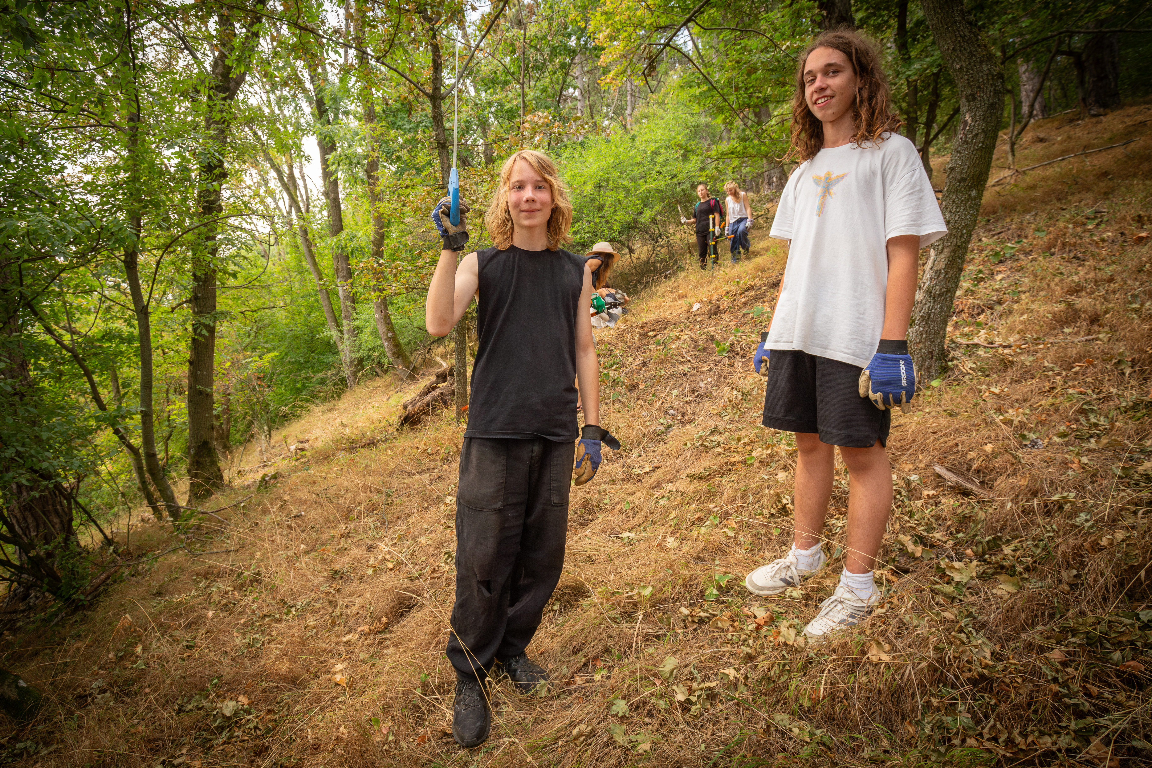

THANK YOU
Restoration Academy
Erasmus+ KA220-YOUTH 2023-2026
Funded by the European Union. Views and opinions expressed are however those of the author(s) only and do not necessarily reflect those of the European Union or the European Education and Culture Executive Agency (EACEA). Neither the European Union nor EACEA can be held responsible for them.
Photo: Frankie Turk

