Slide 1


Inclusion is On
Youth workers’ training model

Slide 2

Funded by the European Union. Views and opinions expressed are however those of the author(s) only and do not necessarily reflect those of the European Union or the European Education and Culture Executive Agency (EACEA). Neither the European Union nor EACEA can be held responsible for them.

Slide 3
Facilitation instructions:
How to use the training model?
The training model consists of several parts, all of them based on the contents of the tool pack produced as part of the Erasmus+ partnership Inclusion is On (2021-2024).
  See contents on the next slide.
You can apply different parts of the training model separately or together to create a training based on your preferences and time available. The model is suitable for both face-to-face and online trainings.
Each part starts with facilitation instructions which provide you the detailed steps and necessary equipment for leading it. Facilitation instructions are hided slides (not visible in presentation mode).
All supporting materials for the training model and other outputs of the project are available in: https://nuortenakatemia.fi/en/incon-projectresults/

Slide 4
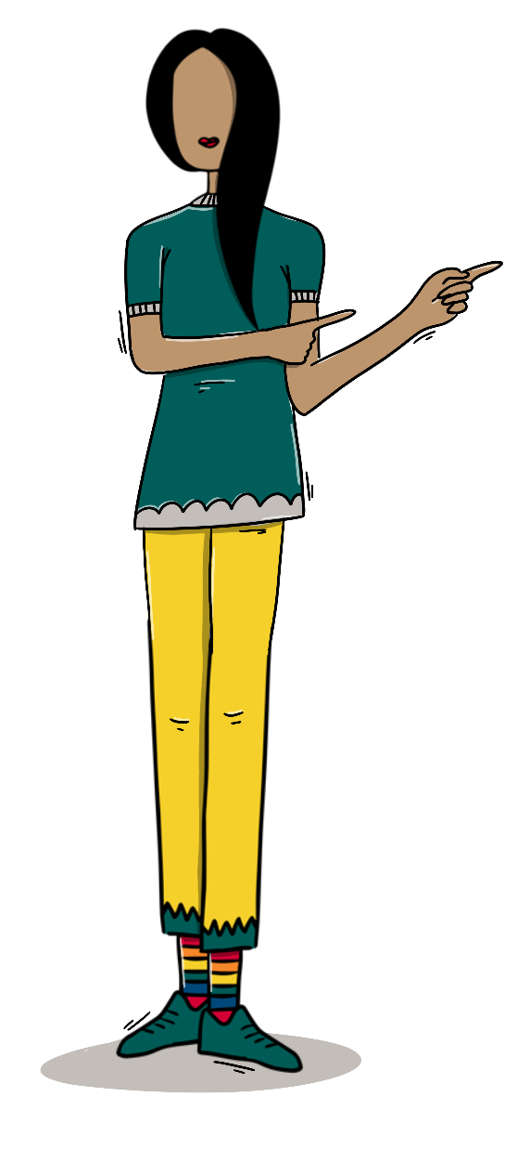
Contents
Introduction of the project
Warm-up activities
Quiz on social inclusion
About safer spaces
Good practices
Innovating new tools: Take the first steps to create a tool
Tools produced by the project partners
Word explanations

Slide 5

Introduction of the project

Slide 6
Inclusion is On
Erasmus+ Youth Partnership in 2021-2024
Topic: Social inclusion in youth free-time activities
  Sharing good practices and innovating new tools
Results​/outputs
  Trainings in partner countries
  Two surveys
  Innovation model
  Tool pack
  Training model
  Podcast series

Slide 7
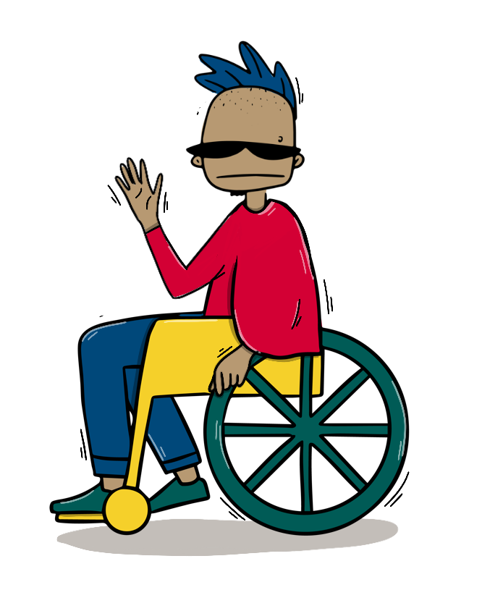
Partners
Youth Academy, Finland​
Finnish Youth Association​, Finland
Radio- R, Czech Republic ​
Tartu Youth Work Center, Estonia ​
Federation of Children´s and Youth Municipal Councils, Hungary ​
Le Discipline, Italy​
Croatian Office for Creativity and Innovation, Croatia

Slide 8

Warm-up activities

Slide 9
Facilitation instructions
Steps, equipment and time:
  Think for a minute by yourself: Tell the participants to reflect the question for 1 minute. No need to write down anything.
  Word cloud: Use, for example, post its and pens or an online word cloud generator such as Answergarden (add the question as a topic, press enter and then show/copy the link of the site so the participants can access to add words with their phones). Depending on the amount of people, give the participants 1-3 minutes to work on the word cloud and then go briefly through what kind of ideas there are in the cloud.
  Discuss with a pair or in a small group: Tell the participants to discuss the questions for 3-5 minutes depending on the amount of people.

Slide 10

Think for a minute by yourself
What is the first thing that comes to your mind about equality in free-time activities?

Slide 11
Word cloud
What does social inclusion
mean to you?

Slide 12
What kind of thoughts does the word cloud evoke in you?
Discuss with a pair or
in a small group
Is there something that surprises you?

Slide 13

Quiz on social inclusion

Slide 14
Facilitation instructions
Steps, equipment and time:
  Go to Kahoot and host a small quiz on social inclusion OR the following slides.
  The quiz includes eight questions, duration approx. 10-12 minutes.
  Participants need, for example, a phone to join the game in Kahoot OR pens and paper to write down their answers if you lead the quiz with the slides.

Slide 15
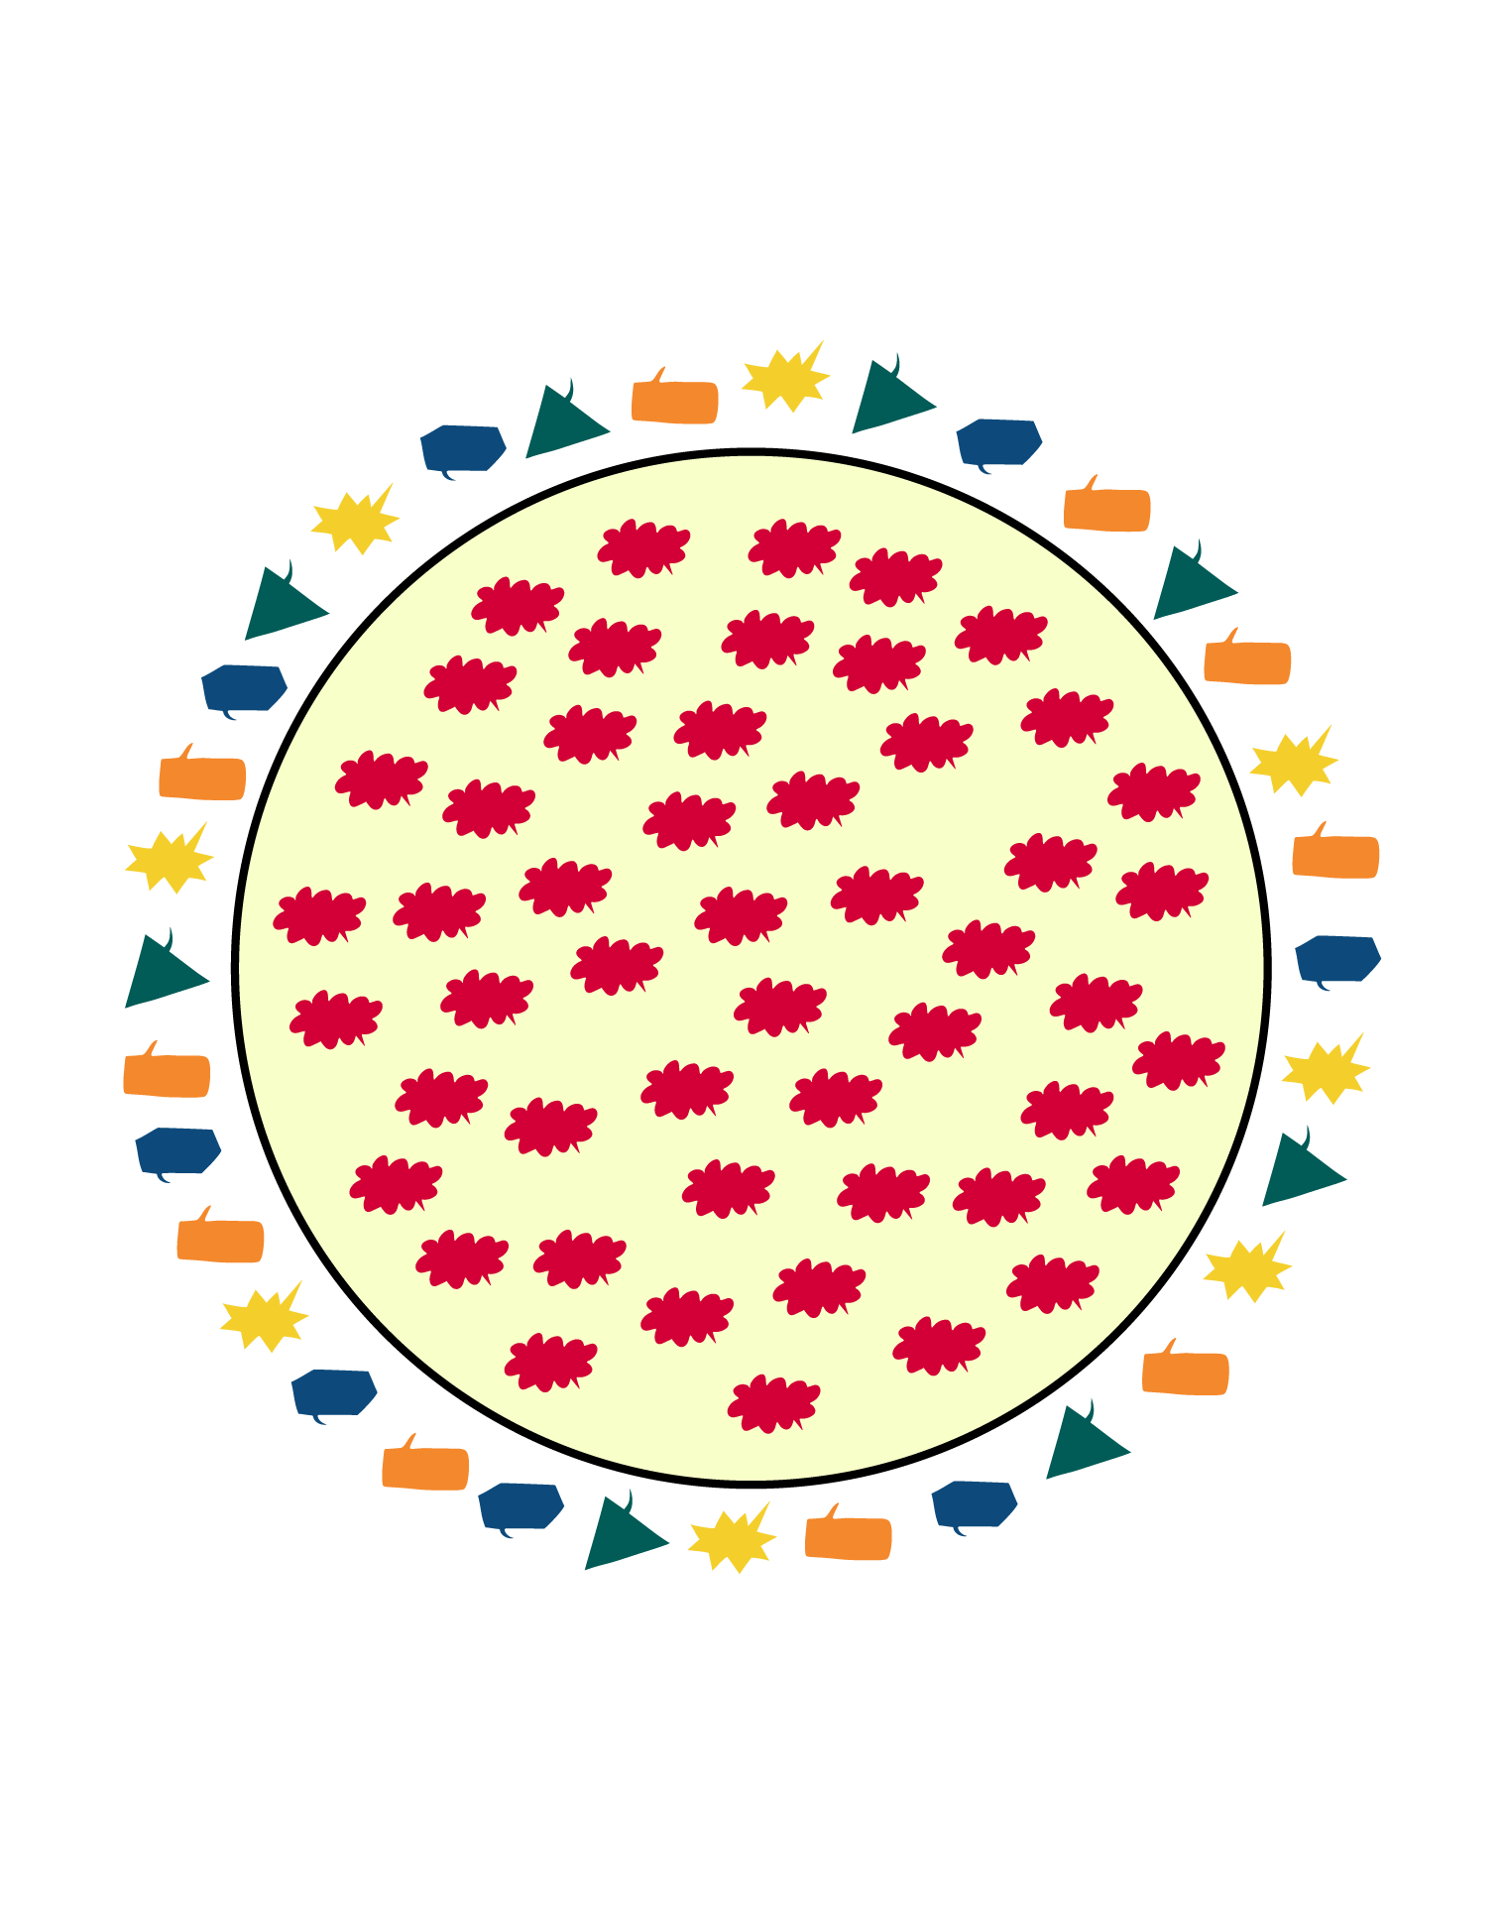
What is the picture about?
inclusion
exclusion
integration
segregation

Slide 16

Which of the following factors are usually connected to risk of social exclusion?
disabilities
socioeconomic status
migration status
gender identity

Slide 17

In Europe, the risk of poverty and social exclusion concerns _____ of young people.
all
half
one third
one fifth

Slide 18
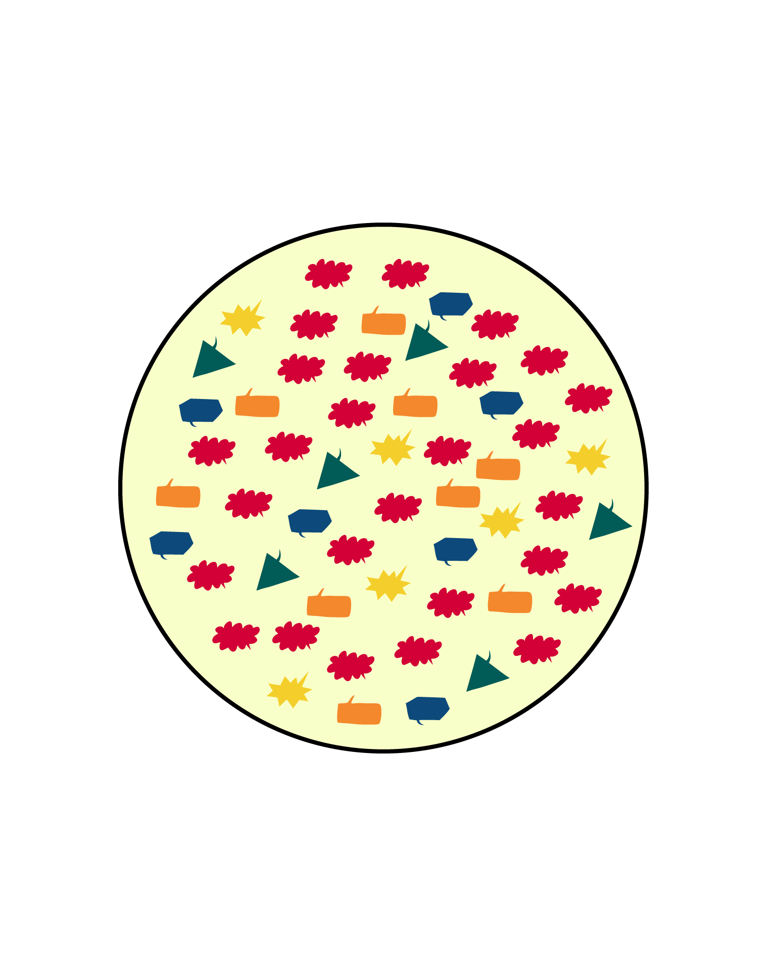
What is the picture about?
inclusion
exclusion
integration
segregation

Slide 19
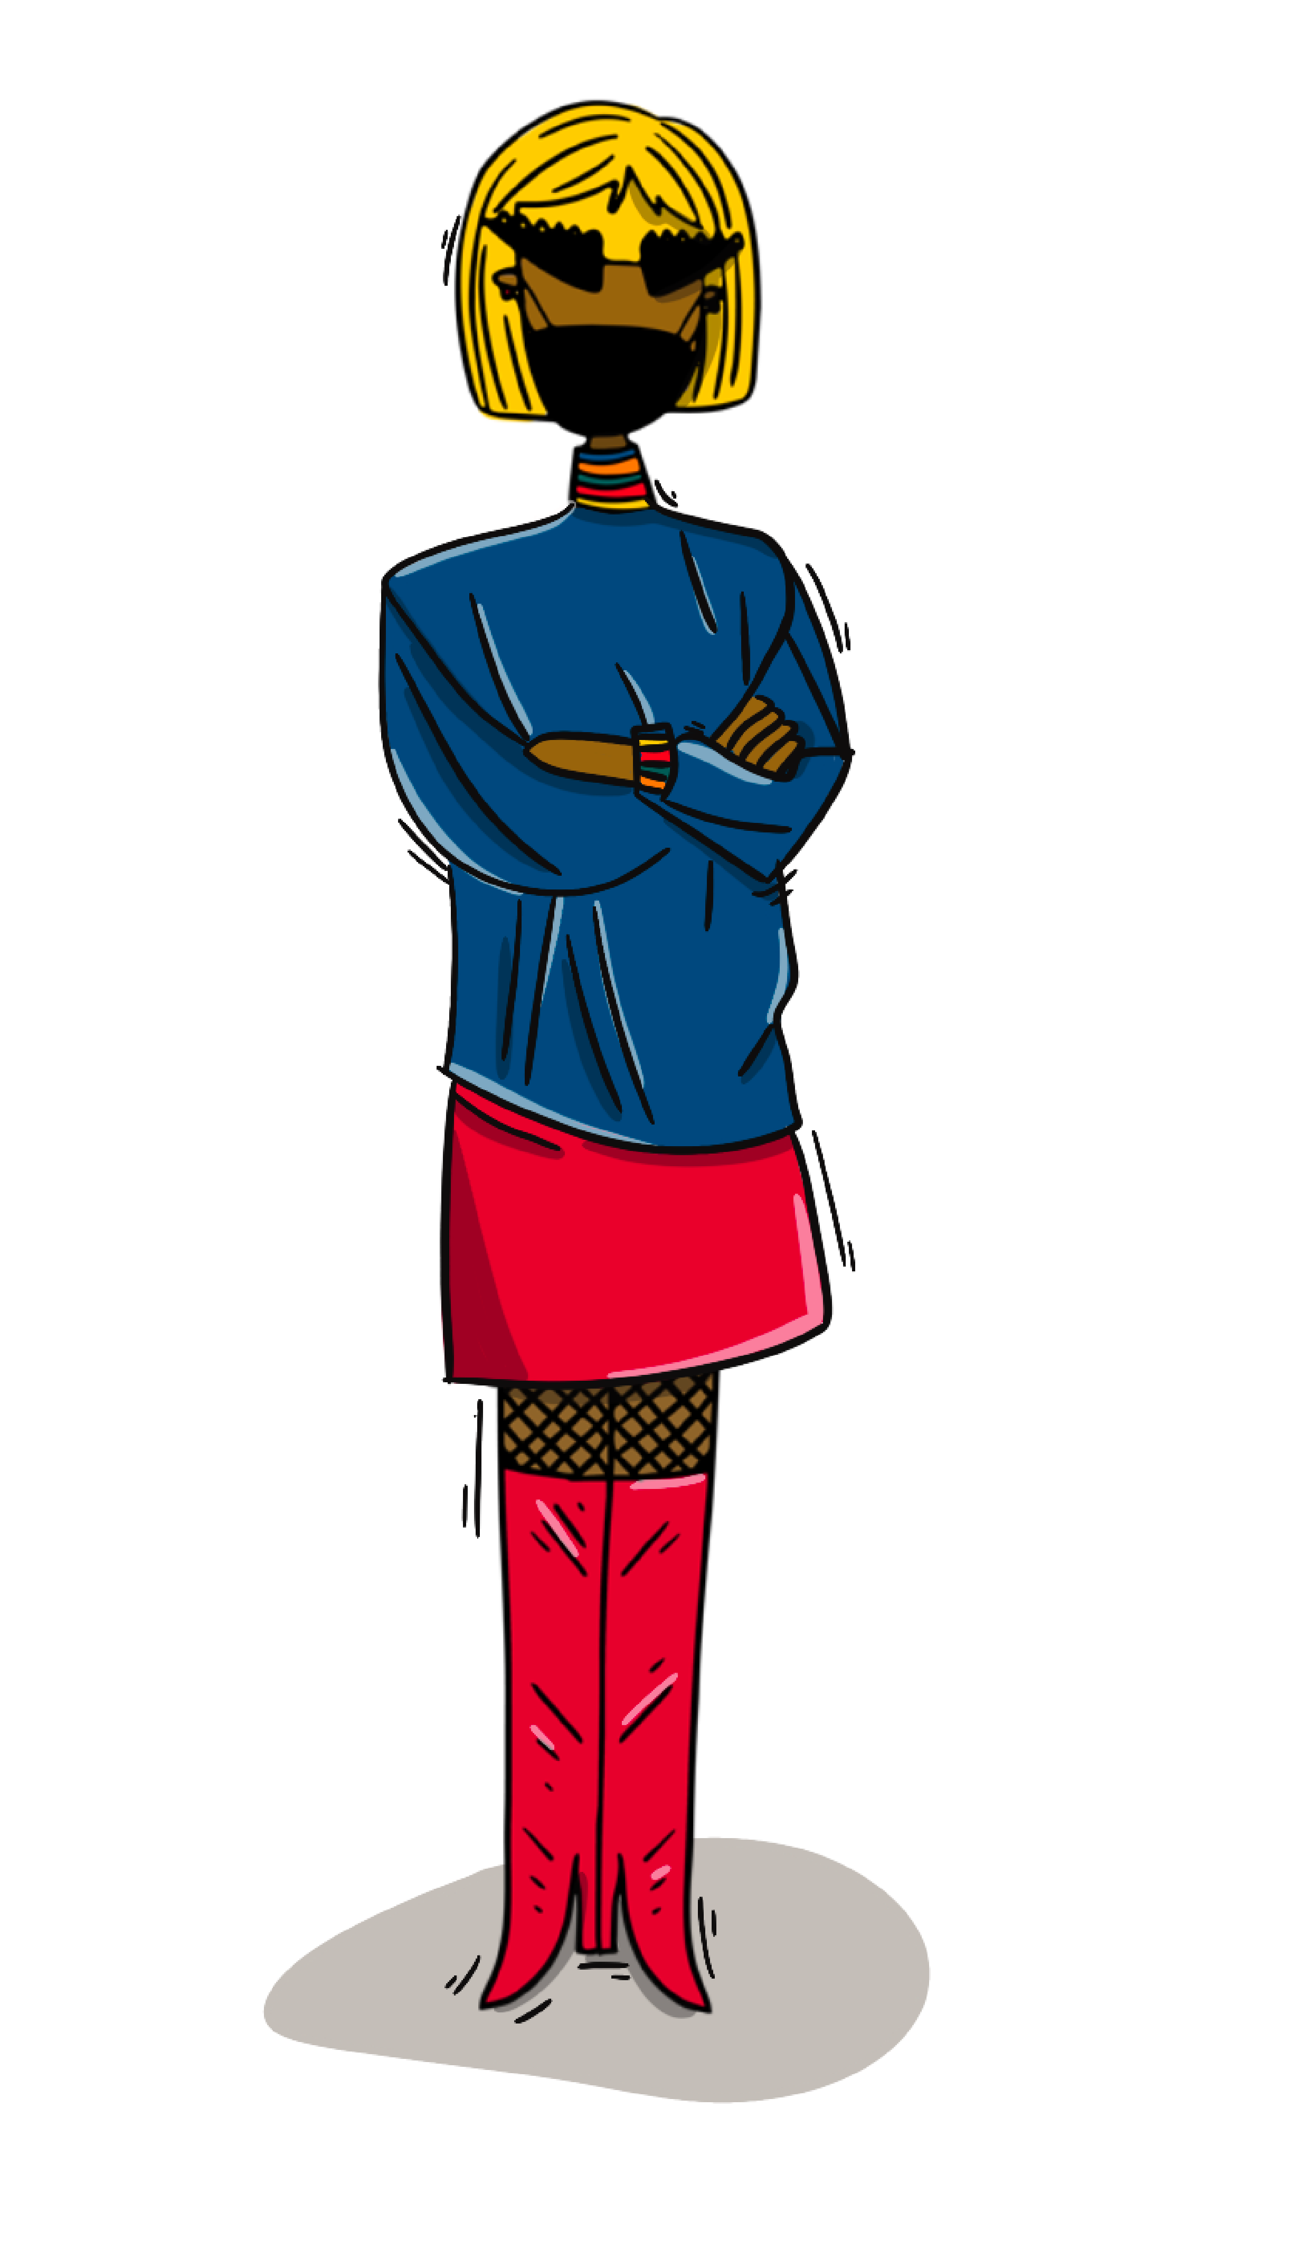
Social inclusion is ”the process of improving the terms for individuals and groups to take part in _____” (World Bank).
free-time activities
politics
society
sports

Slide 20
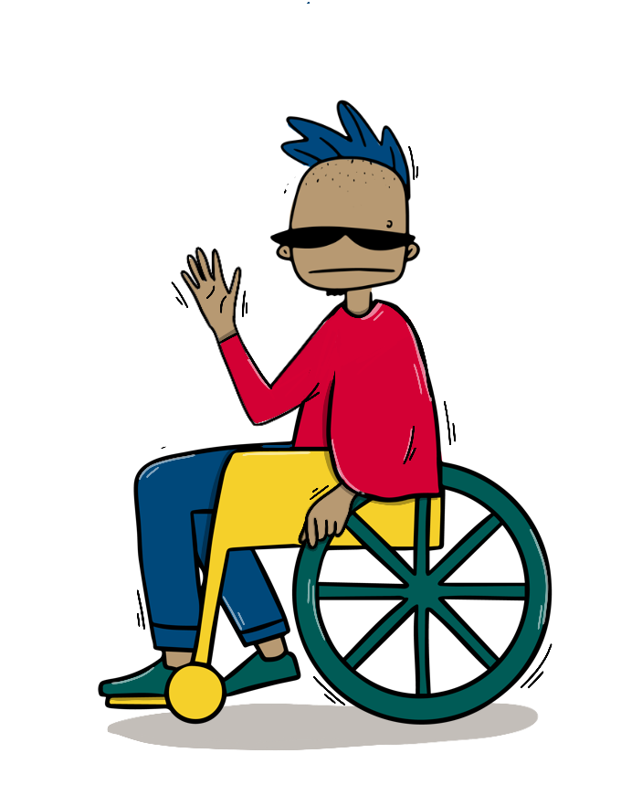
Social inclusion can, for example, be improved by shifts in _____.
cultural habits
personalities
attitudes
sleeping habits

Slide 21
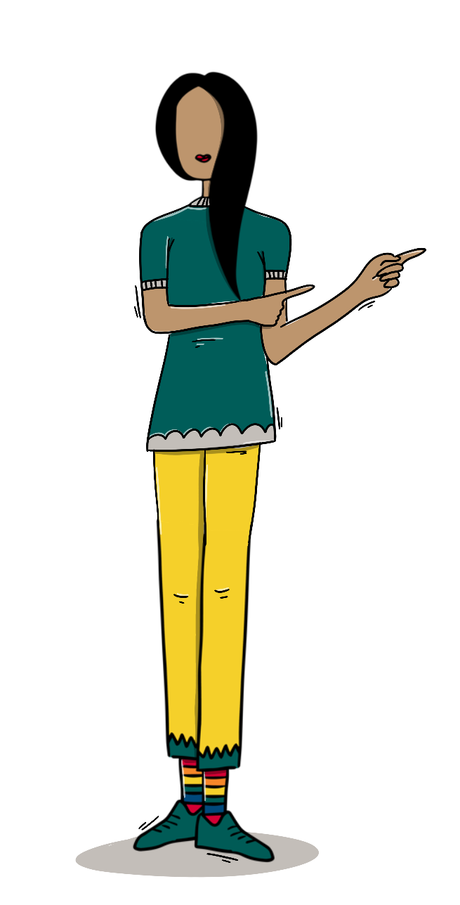
Fostering the _____ of marginalized groups is a remarkable means to tackle social exclusion.
sense of taste
sense of sight
sense of belonging
sense of touch

Slide 22

Promoting social inclusion is also one of the core priorities of the _____.
European Youth Law
Universal Declaration of Human Rights
EU Green Deal
EU Youth Strategy

Slide 23
Correct answers

Slide 24
What is the picture about?
inclusion
exclusion
integration
segregation

Slide 25
Which of the following factors are usually connected to risk of social exclusion?
disabilities
socioeconomic status
migration status
gender identity

Slide 26
In Europe, the risk of poverty and social exclusion concerns _____ of young people.
all
half
one third
one fifth

Slide 27
What is the picture about?
inclusion
exclusion
integration
segregation

Slide 28
Social inclusion is ”the process of improving the terms for individuals and groups to take part in _____” (World Bank).
free-time activities
politics
society
sports

Slide 29
Social inclusion can, for example, be improved by shifts in _____.
cultural habits
personalities
attitudes
sleeping habits

Slide 30
Fostering the _____ of marginalized groups is a remarkable means to tackle social exclusion.
sense of taste
sense of sight
sense of belonging
sense of touch

Slide 31
Promoting social inclusion is also one of the core priorities of the _____.
European Youth Law
Universal Declaration of Human Rights
EU Green Deal
EU Youth Strategy

Slide 32

About safer spaces

Slide 33
Facilitation instructions
Steps, equipment and time:
  What are we talking about: Tell the participants to reflect the question for 1 minute. No need to write anything down.
  What is a safer space? Explain the participants the basic idea of safer space and safer space principles with the support of the slide. ~2 minutes.
  Examples of commonly used safer space principles: Present the participants some commonly used safer space principles with the support of the slide. (You can also mention that different kind of actors can use different kinds of principles; there are no binding declarations on what to include.) ~2 minutes.

Slide 34
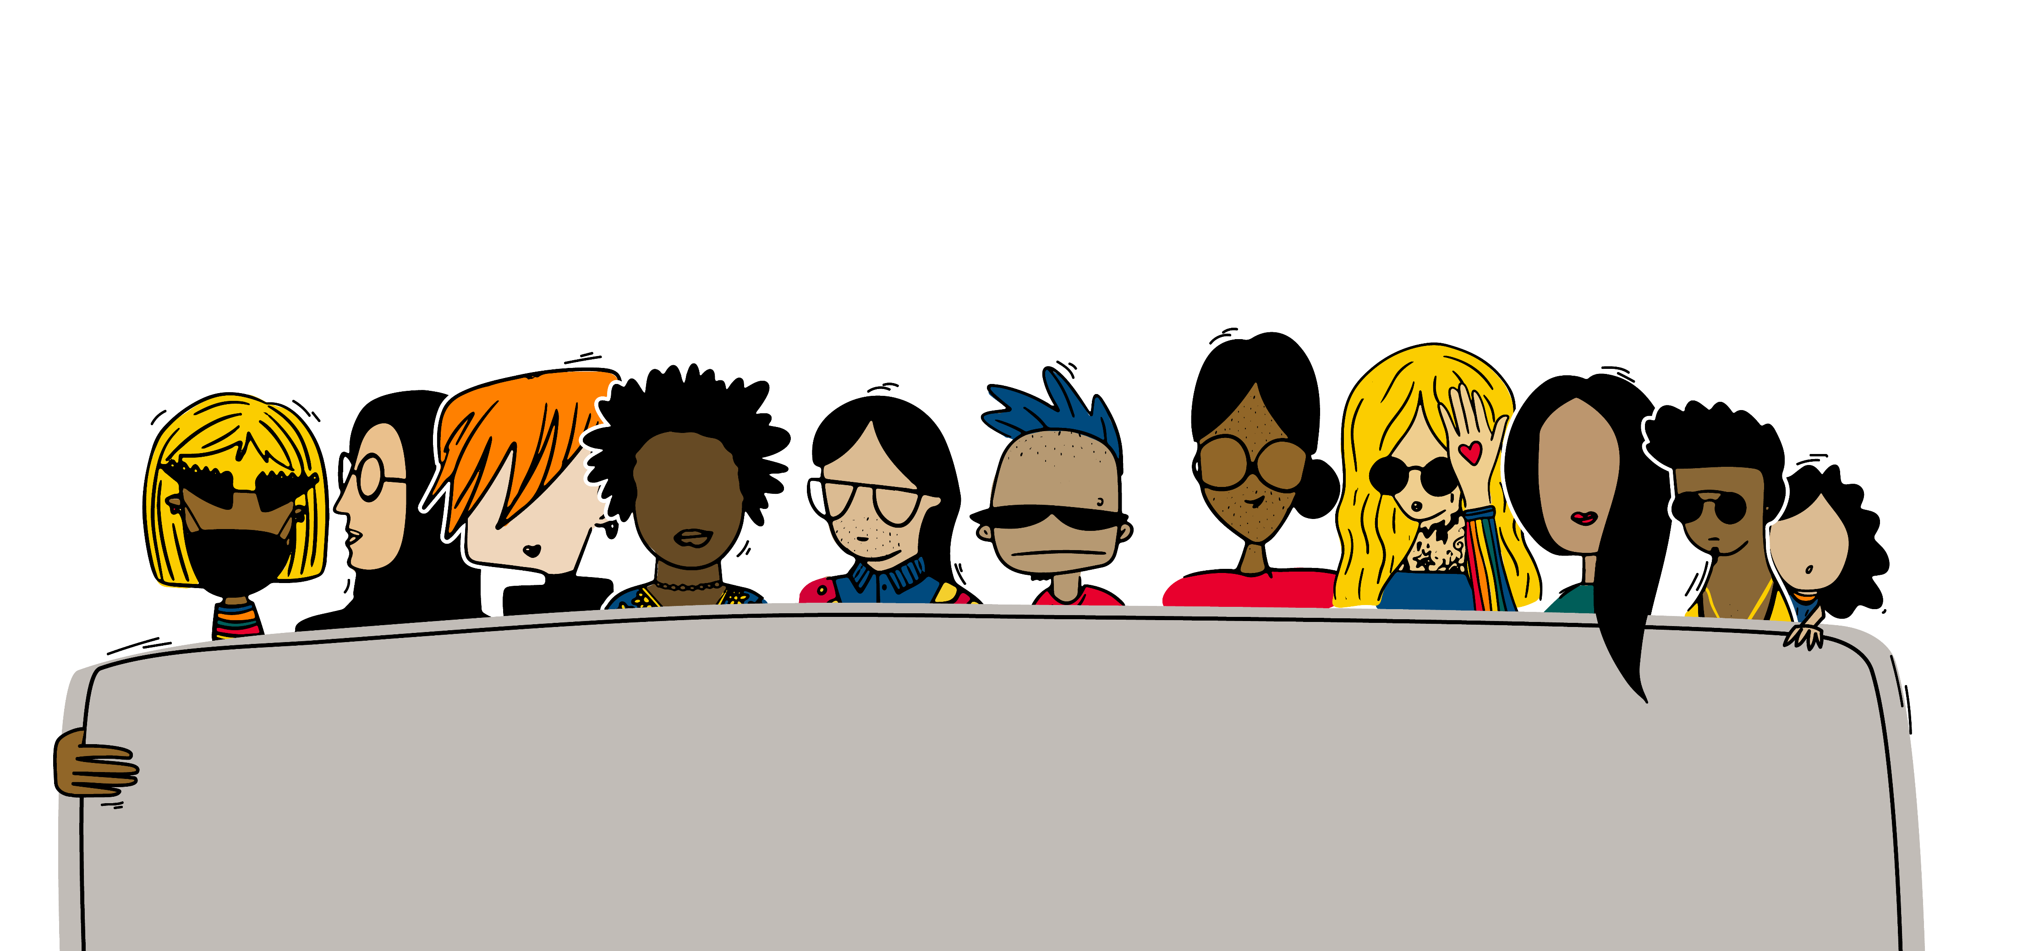
What are we talking about?
Can someone describe what are safer spaces or safer space principles?
If no one is familiar with the topic, try to guess!

Slide 35
What is a safer space?
Safer spaces refer to inclusive environments where everyone can feel comfortable being and expressing themselves as they are.
The purpose of so-called safer space principles is to provide a tool and guidelines or policies for participants or groups to an activity or an event to support creating this kind of safer environments. The main idea is to create conscience, not to be “perfect”. Safer space principles are usually presented as a poster or similar or published and presented to the participants online.

Slide 36
Examples of commonly used safer space principles
We respect other participants.
  Opinions, experiences, right to self-determination and personal boundaries.
We don’t tolerate discrimination, neither question or value the opinions and experiences of others.
We avoid making assumptions and generalizations, for example, on identities.
We give space for everyone to speak, but we do not push anyone to participate.
​We are open to give and receive constructive feedback.
In case of witnessing any discrimination or harassment:
  Contact the equality representative
  Leave anonymous feedback

Slide 37
Good practices

Slide 38
Facilitation instructions
Steps, equipment and time:
  Tell the participants to have a look at the topics of the different good practices (titles of the good practices are on the next slide). ~2 minutes.
  Tell each participant/pair/group to choose one good practice they want to know more about. (Preferably each participant/pair/group chooses a different one, but it does not matter if you don’t get to know all the good practices.) ~1 minute.
  Tell them to go to https://nuortenakatemia.fi/en/incon-projectresults/ and give them some 10-12 minutes to learn more about their selected good practice, after which they will brief the idea and some main points of it to others (~3 minutes per good practice).
  Let the participants discuss the questions on the last slide. ~5 minutes per good practice.

Slide 39
Good practices
Tartu Youth Work Center
Youth Academy
Accessibility of open youth work: Integrating teenagers with visual, hearing and mobility impairments in Tartu into the activities of youth centers with the support of nature education
The Finnish Youth Association
Introduced by hobbies: Accessibility manual to make free-time activities for young people with immigrant background more accessible
Our doors are open for everyone: A guide to more inclusive practices in cultural youth work
GYIOT
Le Discipline
Radio R
Accessibility of youth councils and decision-making processes: A guide for running youth councils and improving decision-making processes
Inclusion and active citizenship: Citizenship Education Group
Enhancing accessibility of university extracurricular activities for youth in difficult situations

Slide 40

What kind of thoughts does the good practice raise in you?
Do you have anything in mind you would like to add on the good practice?
How would the good practice or parts of it fit to your own work?
Do you have some other similar kind of good practices in mind you would like to share?

Slide 41

Innovating new tools: Take the first steps to create a tool

Slide 42
Facilitation instructions
Facilitate the problem tree and five whys workshop for the participants (last slide). Tell the participants to come up with a problem related to the topic of the training, i.e. social inclusion. 20-30 minutes. Participants need blank sheets of paper and (color) pens. (Online they can use e.g. Sketchpad or similar.)
The following slides also include an explanation of the basic idea and simplified presentations of all the steps of the innovation model. Give the participants a brief overview on these before you start the workshop.
Remind the participants the problem tree and five whys are the starting point for the innovation process. If they got interested creating their own tool, they can find detailed instructions and the long version of the innovation model from https://nuortenakatemia.fi/en/incon-projectresults/ (under the project results).

Slide 43
Innovation model
1
The innovation model can be used to create one’s own tools to promote social inclusion and accessibility, or it can also be applied to other thematical areas.
It is based on design thinking methods and the steps offer a systematic approach and structured framework to problem-solving.​
Notes:
Presenter: HUKI

Slide 44
Innovation model
2
You can work individually or in a group
  Preferably 3-5 participants per group.
You need paper, (color) pens and time.
Notes:
Presenter: HUKI

Slide 45
Innovation model
3
Before starting the process, it is recommended to also conduct a short survey/mapping with relevant beneficiaries about the problem to solve.
It is also recommended to have feedback rounds with beneficiaries and stakeholders between the different steps of the model. However, these feedback rounds are not included in the simplified version which follows.
Notes:
Presenter: HUKI

Slide 46

Consequences
Specify the problem
Why is it happening?
Why is that?
Why is that?
Why is that?
Why is that?
Problem tree and five whys
Causes
Notes:
Presenter: HUKI

Slide 47




Who can affect?
Who is also affected?
Target group
Target group and stakeholders
Notes:
Presenter: HUKI

Slide 48

Who can affect?
Basic demographical info
Desires?
Needs?
Frustrations?
Challenges?
Pain points?
Personas
Notes:
Presenter: HUKI

Slide 49

Generating as many ideas as possible to tackle the problem!
  Grouping ideas based on relevance and similarities.
  Defining the pros and cons of each idea to assess its viability.
  Choosing the most promising idea as the foundation for your prototype.
Brainstorming
Notes:
Presenter: HUKI

Slide 50

Creating a tangible representation of the product or service. This is an iterative process, which means you develop different versions of the prototype little by little (prototype 1, prototype 2, prototype 3).
Prototype
Notes:
30 min – screenille tikittävä kello

Slide 51

Resource Planning
Activity Planning
Sustainability Assessment
Cost Estimation
Risk Assessment and Mitigation
Stakeholder Communication
Make it real
Notes:
Presenter: HUKI

Slide 52

Presentation to introduce your proposed solutions
Pitch
Notes:
Presenter: HUKI

Slide 53
Workshop
Problem tree
and five whys
Consequences
Start the innovation process by creating a problem tree and answering the five whys.
Work either individually or in small groups of people preferably from the same organization.
Specify the problem
Why is it happening?
Why is that?
Why is that?
Why is that?
Why is that?
Causes
Notes:
Presenter: Radio R

Slide 54
Tools produced by the project partners

Slide 55
Facilitation instructions
Steps, equipment and time:
  Tell the participants to have a look at the topics of the different tools (titles of the tools are on the next slide). ~2 minutes.
  Tell each participant/pair/group to choose one tool they want to know more about. (Preferably each participant/pair/group chooses a different one, but it does not matter if you don’t get to know all the tools.) ~1 minute.
  Tell them to go to https://nuortenakatemia.fi/en/incon-projectresults/ and give them some 8-10 minutes to learn more about their selected tool, after which they will brief the idea and some main points of it to others (~3 minutes per tool).
  Let the participants discuss the questions on the last slide. ~5 minutes per tool.

Slide 56
Tools
Tartu Youth Work Center
The Finnish Youth Association
Plan to increase the reputation of youth work
GYIOT
Plan to hire employees with the right attitude to safer spaces
Plan to increase awareness about inclusion and safer space during events and programs in the youth sector
Radio R
Le Discipline
Plan to increase motivation and participation level of volunteers inside the organization
Plan for creating a safer spaces policy in our organization

Slide 57
What kind of thoughts does the tool raise in you?
Do you have anything in mind you would like to add on the tool?
How would the tool or parts of it fit to your own work?
Do you have some other similar kind of tools in mind you would like to share?

Slide 58
Word explanations

Slide 59
Facilitation instructions
Steps, equipment and time:
  In the following slides, there are eight words related to the topic addressed in the training model. The slides also include explanations of each word (animated).
  Show the words one-by-one to the participants, let them think for a while and then ask them to explain the meaning of each word (this can be done all together, in pairs or in small groups depending on the amount of participants).
  Encourage the participants to try to describe their ideas or even just guesses; it does not matter if they don’t know the specific meanings.
  After the participants have first given their explanations, show them the description of the word. How did it go; did they more or less know the meaning or was it a new word? You can also ask, what do the participants think about the description provided in the slide.

Slide 60
Equity
Equity ensures that individuals are provided with the resources they need to have access to the same opportunities. While equality indicates uniformity, where everything is evenly distributed among people, equity recognizes that each person has different circumstances and allocates the exact resources and opportunities needed to reach an equal outcome.

Slide 61
Diversity
A range of different things; variety of things or people. Diversity is recognizing differences and then creating an environment that empowers innovations and creativity.

Slide 62
Intersectionality
Framework to describe and understand how different kinds of characteristics may intersect or overlap with each other and so create, for example, different forms of discrimination and unique oppressive experiences.

Slide 63
LGBTIQ+
An acronym that refers to people who identify as lesbian, gay, bi, trans, queer or intersex. The plus stands for the enormous variety of people in terms of sexual orientation, expressing gender identity or sex characteristics.

Slide 64
Multi-based discrimination
Discrimination that occurs because of more than one characteristic such as their gender, race, age, religion, sexual orientation, or any other factor.

Slide 65
Physical accessibility
Designing features that allow people with disabilities to access buildings, streets, and other areas independently and safely. For example, providing ramps, elevators, automatic doors etc. These features let people participate in life regardless of their disabilities.

Slide 66
Prejudice
Unreasonable opinion that is not based on reason or experiences. Can be both positive and negative. The word is often used to refer to a preconceived evaluation of another person that is based on that person's anticipated personal characteristics.

Slide 67
Racism
Discrimination or prejudice against people based on their race, ethnicity or a circumstance relating to ancestry. The idea behind racist practices often is an assumption that people can be divided into separate groups that differ in their social behavior and congenital abilities.

Slide 68
Find all the materials of the project: https://nuortenakatemia.fi/en/incon-projectresults/

